Slide 1


Carruthers and Jackson Summer School for Data Leaders 2022
Carruthers & Jackson Summer School 2023

Slide 2
Welcome to Week 3
Class of 2023

Slide 3

Our Program Partners

Slide 4



Today’s Presenters
Caroline Carruthers
Ashley Cairns
Peter Jackson

Slide 5

Introducing Immuta: This week’s class partner
Mark Semenenko
Director, Solutions Architecture, Immuta

Slide 6
The community platform and housekeeping

Slide 7
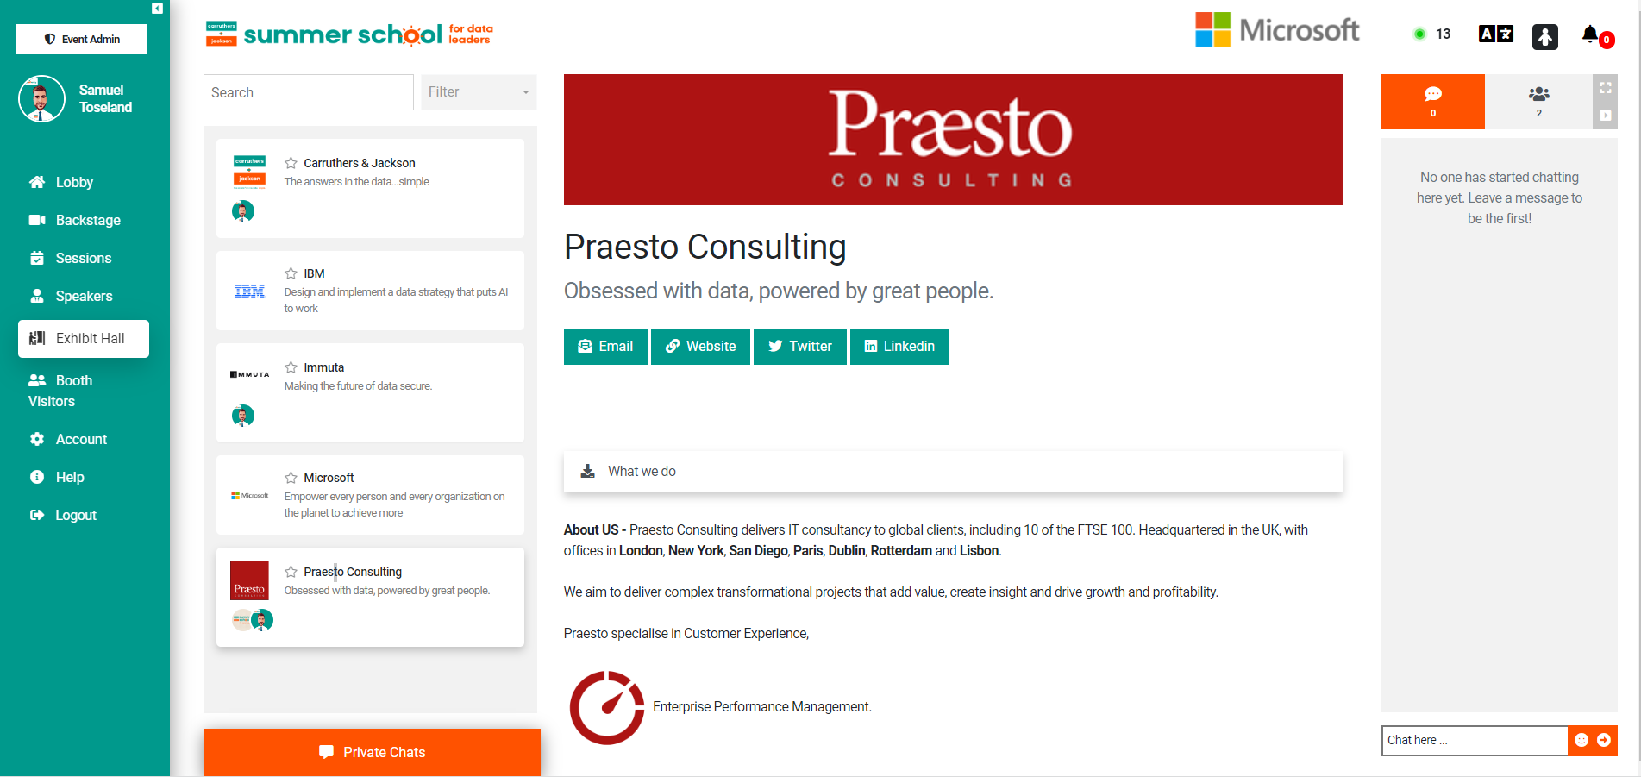
Exhibit Hall – Meet our exhibitors
Notes:
Exhibit hall – Here you will see all of our sponsors, you can scroll through there halls to see all information, also contact them through email or chat

Slide 8





Where to find support: Your community manager Sam Toseland
+ 44 (0) 7861669311
stoseland@carruthersandjackson.com

Slide 9
Lookback: Class 2
Making the case for the CDO

Slide 10
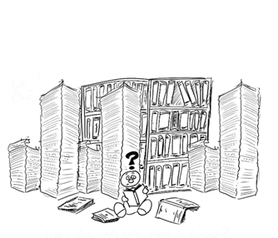
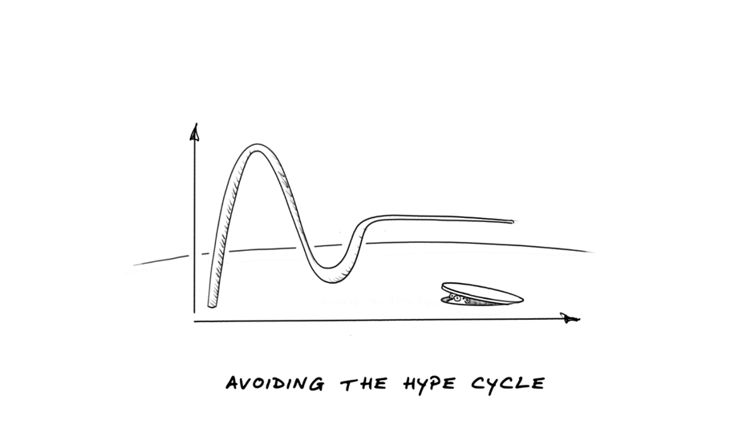
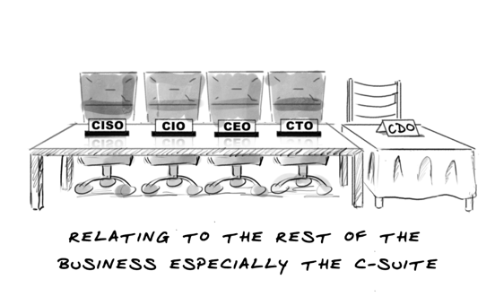
What will you face?
Legacy ‘Everything’
The Hype Cycle
The Rest of the C-Suite

Slide 11
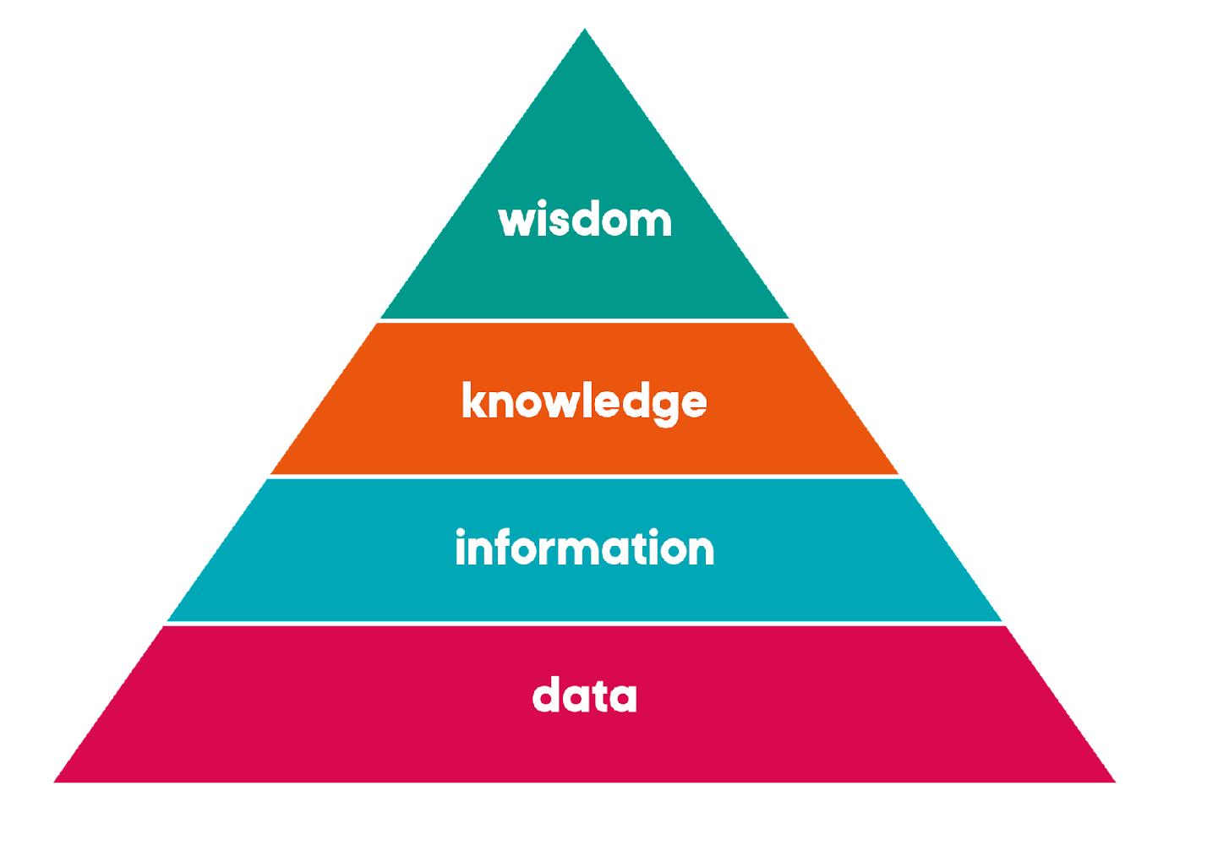
DIKW Triangle

Slide 12
Scott Taylor:
Data Storytelling

Slide 13
Program Overview

Slide 14
The Program
Week 1 June 29 Understanding the different types of CDO & what kind of CDO you are
Week 2 July 6 Making the case for the CDO and telling your data story with the 3Vs
Week 3 July 13 Planning for your first 100 days and beyond and the C&J Data Maturity Assessment overview
Week 4 July 20 Strategy development: Purpose
Week 5 July 27 Strategy development: Risk and Governance
Week 6 August 3 The role of People
Week 7 August 10 Methodology
Week 8 August 17 Tools
Week 9 August 24 Building your team & authentic leadership
Week 10 August 31 The Chief Data Officer as a disrupter & wrap up of the Summer School 2023

Slide 15
Class 3
Planning for your first 100 days and our Maturity Overview

Slide 16
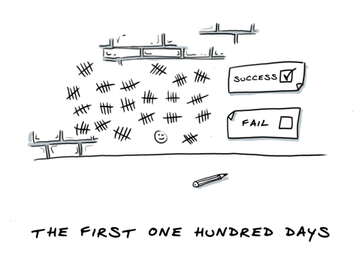
The first 100 days
The case for change
Pre-work
Vision and strategy
Get your basics right Governance Information Architecture Engagement
Quick wins

Slide 17
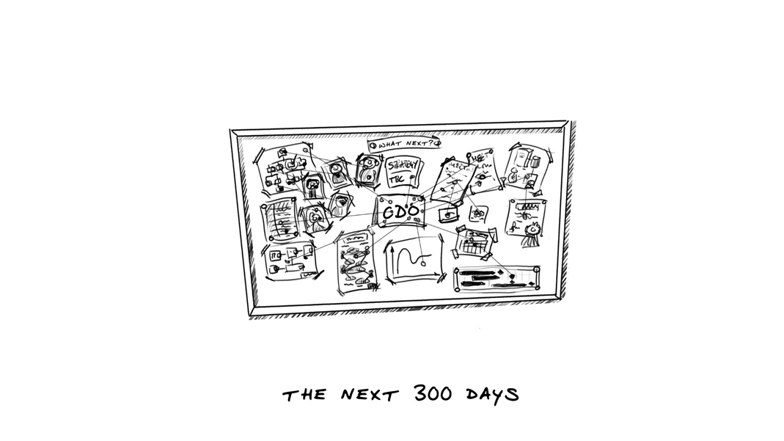
And beyond: The next 300 days
Draw a breath
Create the story
Draw back, think and plan
Rely on your team
Deliver the Immediate Data Strategy
Adopt the Target Data Strategy

Slide 18
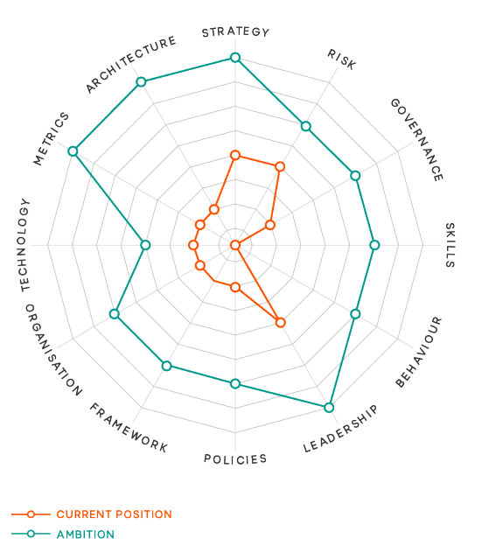
Data Maturity Assessment
Understand where you are
Measurable domains for the elements of data maturity
Evidence-based
Perception vs. reality
Collaboration and shared understanding
Education

Slide 19
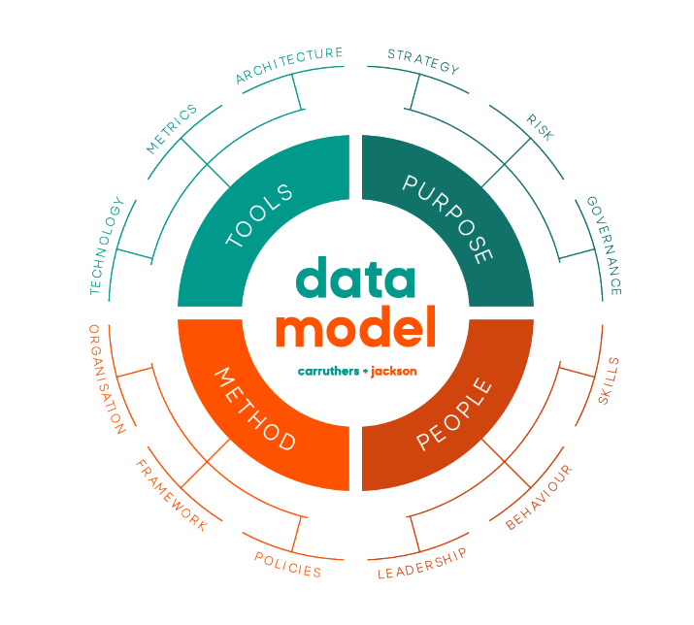
Data Maturity Model
The data model is based upon 4 core areas, each of which contribute to data maturity:
Purpose - we know where we are going
People - we have inspired and capable people doing the right thing
Method - everybody understands what they need to do and how
Tools - everyone has what they need to do their jobs effectively

Slide 20
The level ratings!
Rating | Guidance
0 | Unaware, the organisation has no understanding of the relevance or importance of this element.
1 | Aware, few processes other than those required by legal demands or regulation exist within the organisation, ad hoc efforts with very low levels of trust.
2 | Reactive, some processes are emerging, not monitored and regularly worked around, data quality checks are done ad hoc, the idea of standards are starting to emerge but normally in response to an issue faced or direct data breach. Activities tend to be functional and not consistently applied across the organisation.
3 | Proactive, processes developed with limited authority; a more consistent cross functional approach to data management has started and governance of data begins to emerge. Starting to get ahead of the curve but there still seems like a long way to go.
4 | Managed, information governance is in place and functions at enterprise level, stewards and champions are working together. A cohesive framework is developing which is communicated, understood and embedded. Continuous data improvement is evident with data thinking embedded in all activities.
5 | Optimised, the majority of information assets, including external sources, are inventoried. Information is advocated across the business, demonstrated through enablement and value generation. Transformative data is used internally and externally to enhance business performance. True partnerships with customers and suppliers are embedded and the data landscape is trusted and agile.

Slide 21

Approach 1: Workshops
Cross-organisational teams work best for the workshops
Guide your teams through a discussion on each of the twelve elements, rating each one using a 0-5 scale. Before moving on, note the rationale.
The debate is the important part of this, the score facilitates the conversation.
For each element discuss the element and its relevance for:
      Your team
      The organisation

Slide 22

Approach 2: Interviews
Conduct a small number of interviews with senior stakeholders
Focus on simple, high-level questions to let them do the talking
Use the model to frame the conversation
Do not take them step by step through as you do in the workshops

Slide 23

And then, pull it all together
Use the information that you have to understand your data maturity
Pull together the stories and scoring into a report that you use to reflect back to your participants
Use this to look at where your biggest problem areas are
Create a high-level presentation to use as part of your data storytelling
Do not waste the opportunity to communicate, this is a brilliant tool to stimulate interest and conversation

Slide 24
A word from this week’s
class partner

Slide 25
Introducing Immuta: This week’s class partner
The secret to all data trends: Trust, collaboration and Security as the foundation for Success
Presented by Mark Semenenko
Director, Solutions Architecture, Immuta

Slide 26
Class discussion

Slide 27

Question and Answer

Slide 28
Next week’s class

Slide 29
Week 4: Purpose - Strategy
Thursday July 20
  08.00 PDT
  11.00 EDT
  16.00 BST
  17.00 CEST

Slide 30
Closing Remarks

Slide 31
Thank you and see you next week!
Back in class on Thursday July 6

